Slide 1
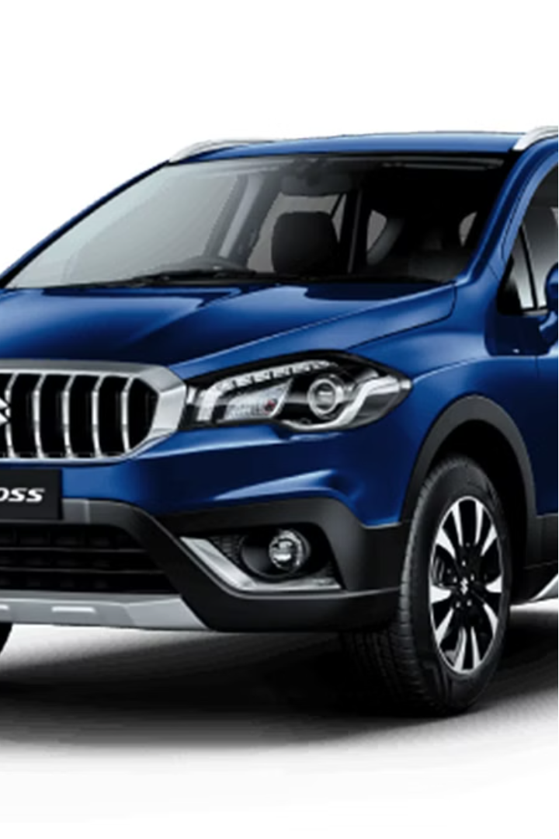
Examining Maruti Suzuki’s Marketing Impact on Customer Purchasing Behavior
Maruti Suzuki, a dominant player in the Indian automotive market, is known for its innovative marketing strategies that have significantly impacted consumer purchasing behavior.
Objectives:
Analyze Maruti Suzuki’s Marketing Strategies
Understanding Consumer Perceptions and Preferences
Evaluate the impact on Purchasing Behavior
Identify drivers of Brand Loyalty and Image

Slide 2
Literature Review: Insights into Maruti Suzuki's Strategies
Maruti's Targeted Approach
Pranay, Bokade., Abhishek, Pande., Meenal, Pendse. (2020).
Regional Insights
Dr., Ashamayee, Mishra.
, Mr., Suraj, Soni. (2022).
Factors Influencing Purchases
Bhumi, Patel, and Trishna Shah
Studies highlight Maruti Suzuki's focus on low and middle-income groups, as well as its efforts to continuously upgrade its product offerings and embrace digitization to stay relevant in the dynamic auto industry.
Research has also explored buyer behavior towards Maruti's small cars in specific regions, providing valuable insights into consumer preferences and purchasing decisions.
Existing literature has analyzed the influence of factors like product quality, brand awareness, and promotional activities on purchasing decisions for Maruti vehicles, as well as the impact of brand equity and pricing on buying behavior in the broader automotive industry.

Slide 3

Data Collection: A Comprehensive Approach
1
Primary Data
The study will collect primary data through qualitative interviews with consumers, marketing professionals, and industry experts, as well as focus group discussions to explore key themes. Quantitative surveys will also be conducted to understand purchasing behavior and perceptions.
2
Secondary Data
The researchers will gather secondary data from academic journals, industry reports, company websites, and government publications to supplement the primary data and provide a comprehensive understanding of the topic.
3
Mixed Methods
The study will employ a mixed methods approach, combining qualitative and quantitative research techniques to gain a deeper insight into Maruti Suzuki's marketing strategies and their impact on consumer behavior.

Slide 4
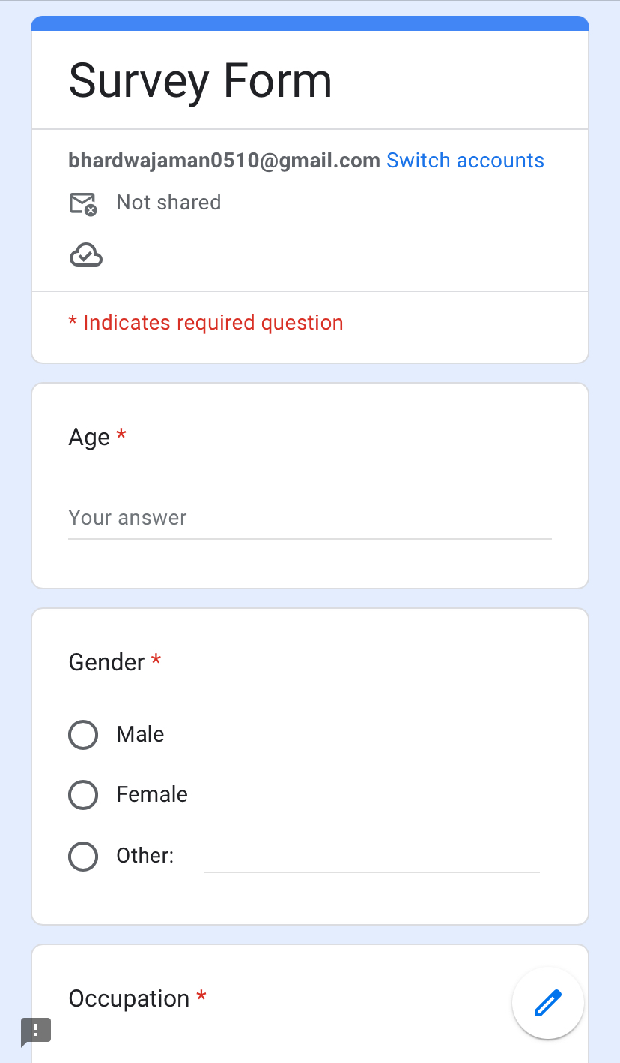
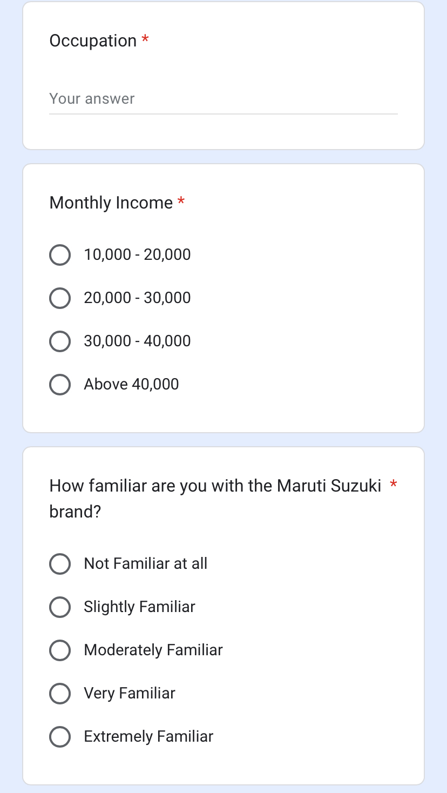
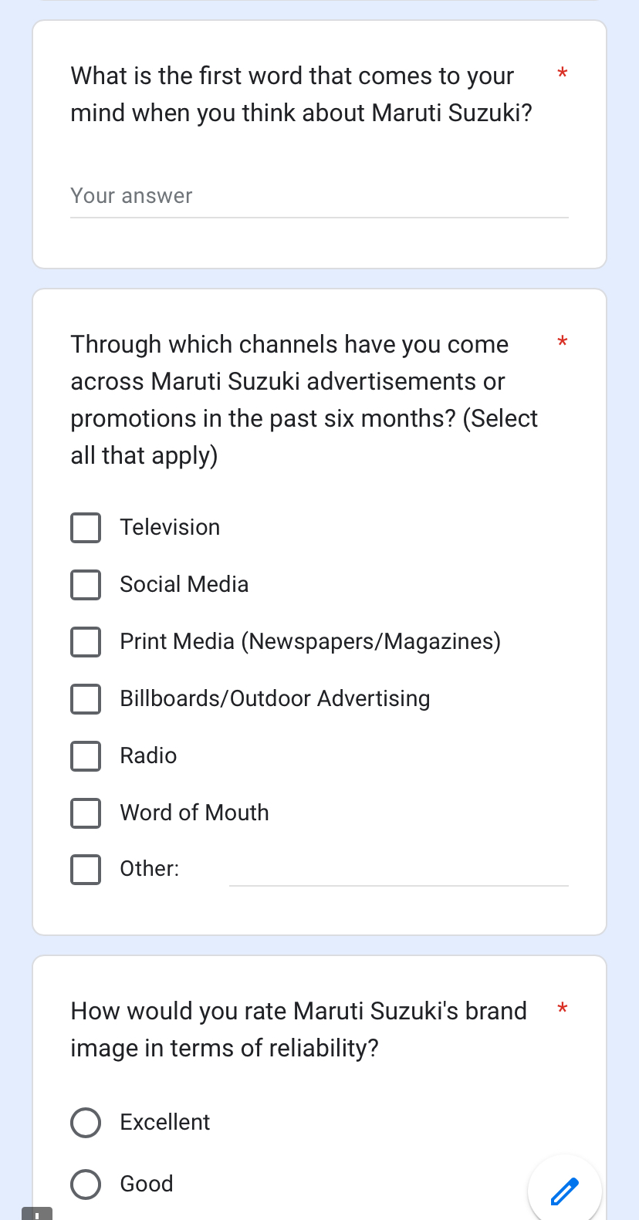
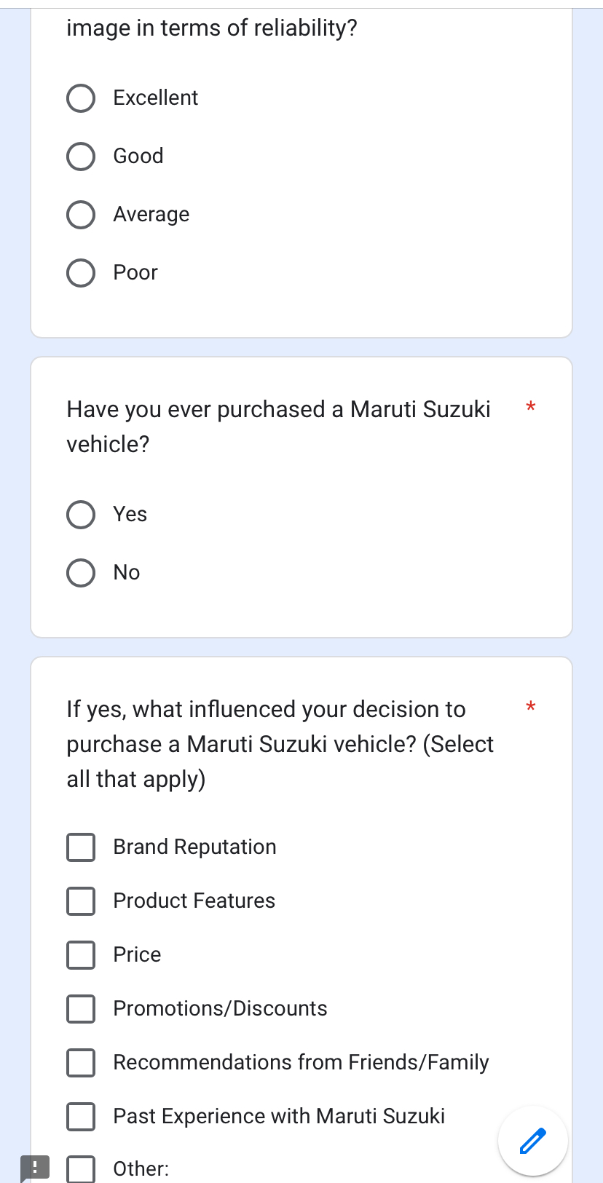
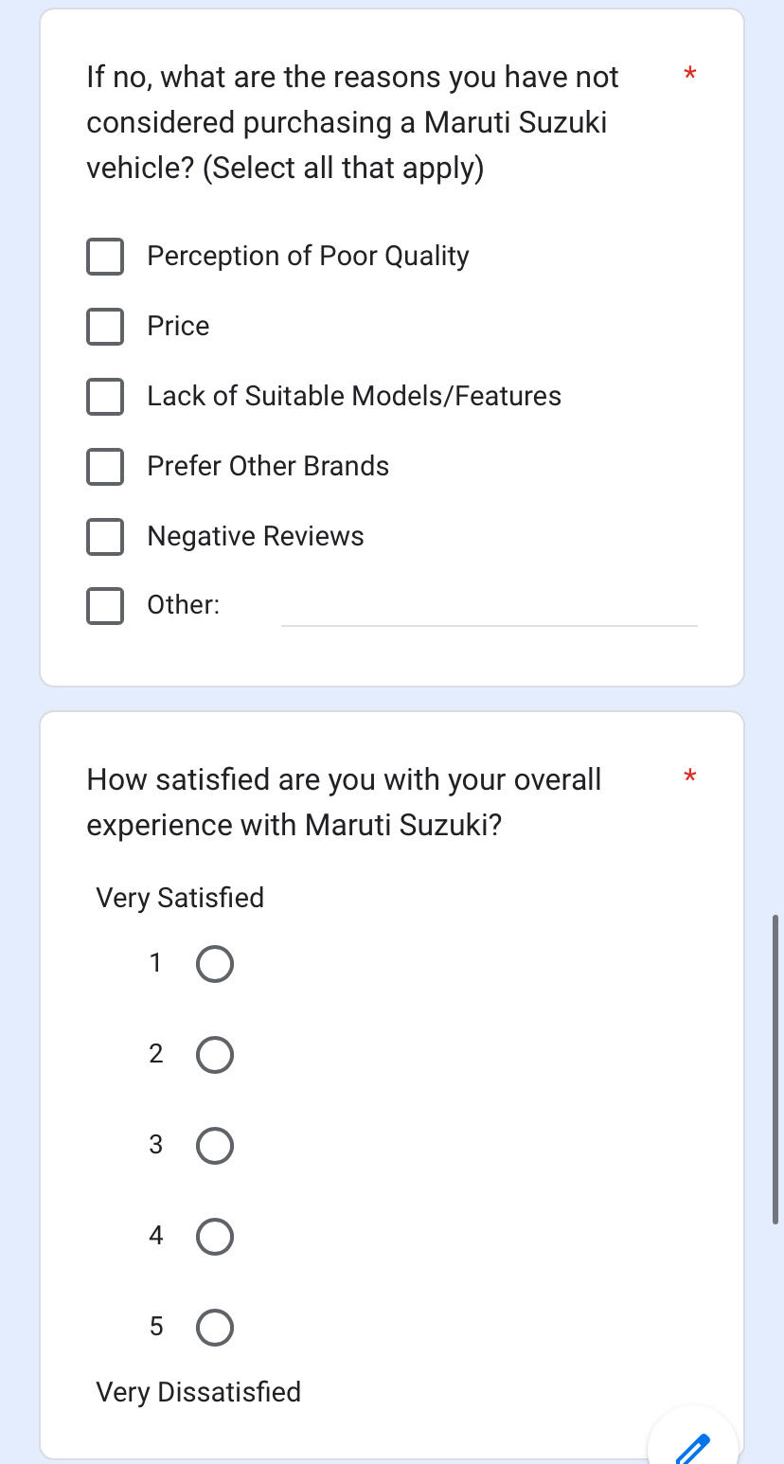
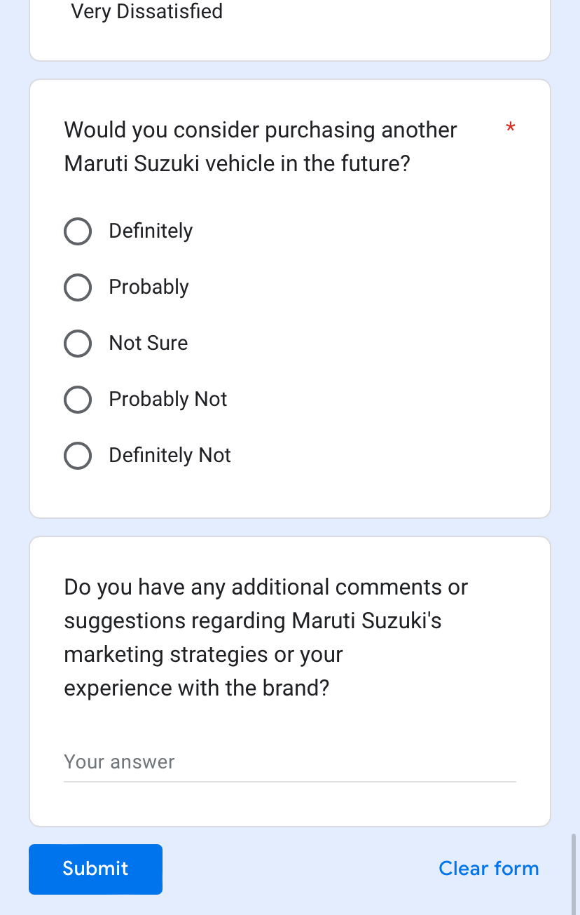

Slide 5

Research Methodology: Rigorous Analysis
1
Qualitative Analysis
2
Quantitative Analysis
3
Mixed Methods Approach
Qualitative data will be analyzed to identify common trends and patterns. This involves thoroughly examining the responses and grouping them based on similarities.
The quantitative data will be analyzed using descriptive statistics, such as frequencies and percentages, as well as inferential analysis techniques like Annova and regression, with the help of excel.
The combination of qualitative and quantitative research methods will provide a comprehensive understanding of the research problem and enable the researchers to draw robust conclusions.

Slide 6
Findings : Quantitative Analysis
CORRELATION (MULTIPLE R)
Age and monthly income together show a strong positive correlation with Maruti Suzuki car purchases (Multiple R = 0.73)
1
SUMMARY OUTPUT
Regression Statistics
Multiple R | 0.728681815
R Square | 0.530977188
Adjusted R Square | 0.526141901
Standard Error | 34882.13541
Observations | 99
ANOVA
 | df | SS | MS | F | Significance F
Regression | 1 | 1.33616E+11 | 1.33616E+11 | 109.8129683 | 1.24168E-17
Residual | 97 | 1.18026E+11 | 1216763371
Total | 98 | 2.51642E+11
 | Coefficients | Standard Error | t Stat | P-value | Lower 95% | Upper 95% | Lower 95.0% | Upper 95.0%
Intercept | -80311.39777 | 18256.81857 | -4.398980987 | 2.7911E-05 | -116546.1289 | -44076.66665 | -116546.1289 | -44076.66665
35 | 5241.914377 | 500.2223675 | 10.4791683 | 1.24168E-17 | 4249.111446 | 6234.717307 | 4249.111446 | 6234.717307
2
PREDICTIVE POWER (R SQUARE)
Approximately 53% of the variation in Maruti Suzuki purchases can be explained by age and income (R Square = 0.53)
3
SIGNIFICANCE (ANNOVA)
Both age and income are statistically significant predictors of Maruti Suzuki purchases (p < 0.001)
Insights
1) Older individuals with higher incomes are more likely to purchase Maruti Suzuki cars.
2) Other factors beyond age and income may also influence purchasing decisions, such as brand loyalty and specific car preferences.

Slide 7

Insights into Consumer Perceptions
Diverse Respondents
Brand Familiarity
The study had an equal representation of male and female respondents, indicating Maruti Suzuki's broad appeal across genders. Respondents were from diverse professions and income levels, providing a comprehensive understanding of the target market.
Most respondents were moderately or very familiar with the Maruti Suzuki brand, highlighting its strong presence and recognition in the Indian automotive market.
Influential Factors
Brand Perception
Social media and word-of-mouth were identified as significant influencers in the purchasing decisions of Maruti Suzuki customers, underscoring the importance of these channels in the company's marketing efforts.
Maruti Suzuki was perceived by respondents as a reliable, affordable, and trustworthy brand, which are key factors contributing to its success in the Indian market.

Slide 8




Evaluating Customer Satisfaction
Overall Satisfaction
Product Ratings
The study found high overall satisfaction levels among Maruti Suzuki customers, indicating the company's success in meeting their expectations.
The majority of respondents rated Maruti Suzuki's products as "Good" or "Excellent", indicating high levels of customer satisfaction with the company's offerings.
Purchase Intentions
Price Sensitivity
While Maruti Suzuki is perceived as an affordable brand, addressing price sensitivity could be an area for improvement to attract more customers.
A significant number of respondents expressed their intention to consider Maruti Suzuki for their future vehicle purchases, demonstrating the brand's strong appeal and customer loyalty.

Slide 9
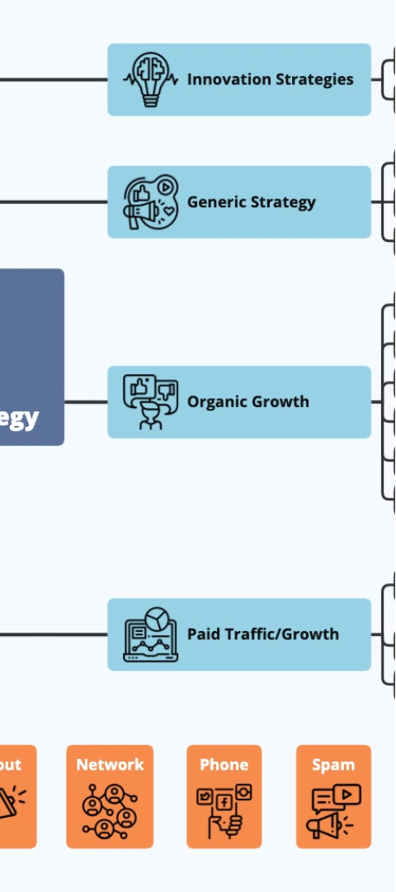



Recommendations: Enhancing Maruti Suzuki's Strategies
Leverage Word-of-Mouth
Encourage positive word-of-mouth by building trust and delivering exceptional customer experiences to further strengthen Maruti Suzuki's brand reputation.
Competitive Pricing
Offer competitive pricing to attract more customers and address price sensitivity, while maintaining the brand's value proposition.
Highlight Product Benefits
Emphasize the unique features and benefits of Maruti Suzuki's products to showcase their value and differentiate the brand in the market.

Slide 10
Conclusion: Maruti Suzuki's Continued Success
Maruti Suzuki's marketing strategies have successfully resonated with a diverse range of customers, appealing to both male and female consumers across different income levels and professions.
Resonance with Diverse Audiences
Factors such as brand reputation, pricing, product features, and word-of-mouth recommendations have played a significant role in shaping customer purchasing decisions for Maruti Suzuki vehicles.
Factors Influencing Purchases
Digital channels and word-of-mouth have emerged as vital influencers in the automotive market, underscoring the importance of these channels in Maruti Suzuki's marketing efforts.
Digital and Word-of-Mouth Impact
While Maruti Suzuki has established a robust brand and offers value-driven products, the company should continue to focus on customer satisfaction and address areas for improvement to maintain its market dominance.
Continuous Improvement

Slide 11
Thank You
Name : Aman Bhardwaj
Roll No. : 2022PBA9271
Batch : MBA 2nd Year

